Slide 1

Mintzberg’s Organizational Structures: Classic & New Models
Team Members:
Deborah Ghirmay ELIAS
Giancarla ROSAS AGRAMONT
Sayed Qasem MOSTAFAVI

Slide 2
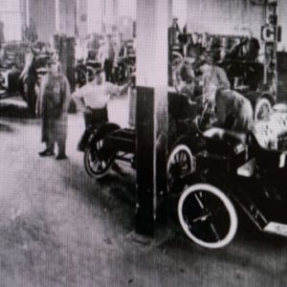
Evolution of Organizational Classification of Structures: 1900s–Present
Dive into Henry Mintzberg’s seminal work on organizational design, a framework crucial for understanding how companies are built and operate.
Foundational Theory Explore Mintzberg's core principles of organizational configurations.
Classic Structures Unpack the five traditional models with compelling real-world company examples.
New Models Discover the contemporary additions: Political and Missionary organizations.

Slide 3
Classical Organization Theory (1900s–1930s)
Classical organization theory was the first major framework for understanding organizations.
Management in the classical period was highly authoritarian and centralized compared to later stages.
Classical Organization
Bureaucratic / functional hierarchy
Simple line organization
Line-and-staff

Slide 4
Bureaucratic / functional hierarchy (classic bureaucracy) Ex: Ford Model T factory (c. 1910)
Founder
Top Administration
Factory
Production Organization
Departments and Testing
Major components process and quality control
Production unit and Labors

Slide 5
Simple line organization (line structure)
Small owner-manager firms (generic example)
Owner
Supervisor
Frontline Employees

Slide 6
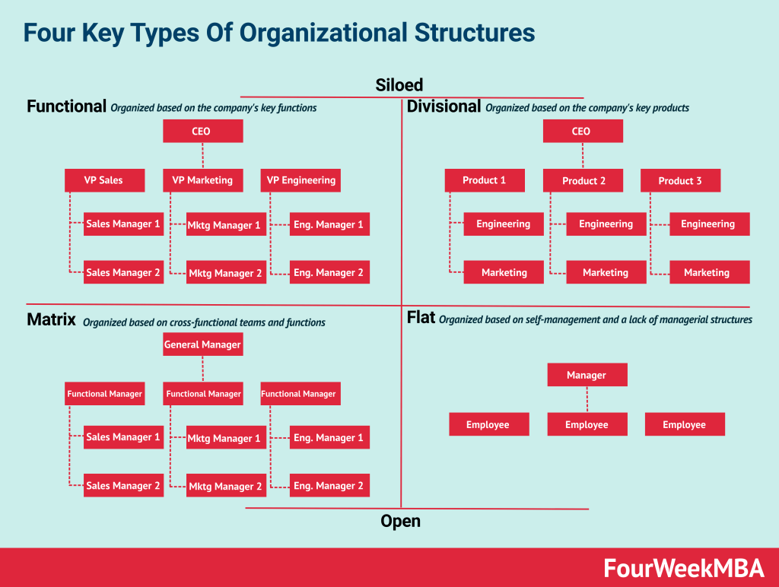
Structural Differentiation in Large Corporations (1940s–1960s)

Slide 7
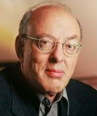
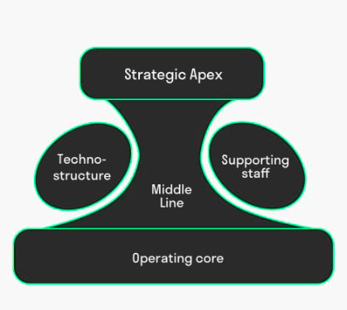
Mintzberg’s Theory
Henry Mintzberg is a management researcher
How are organizations built, and why do they work the way they do?
Organisational structure base on the “fly”: head and eyes of a fly
Middle management
Top Management
Staff organisations that play supporting role
Technological support of an organisation
Working base

Slide 8


Simple structure
Flat structure and heavy strategic top
Direct supervision / regulation of all processes
Starting business: control over all
Machine bureaucracy
Enormous standardisation of work processes
Heavy middle management, focus on technical structure
Work according to procedures and are recorded, analysed and checked
Notes:
Simple structure:
No formal structure (yet)
Standardised systems are missing
Machine bureaucracy:
Ministries and municipal goverments / production companies
Dep operate separately from each other and develop opposing interest

Slide 9
Mintzberg’s Configurations (1970s–1980s)
Bill Gates
Small Core Team
Product Developement
Software Developers
Sales/Customer Contact
Admin
Early Microsoft (late 1970s)
Simple Structure

Slide 10
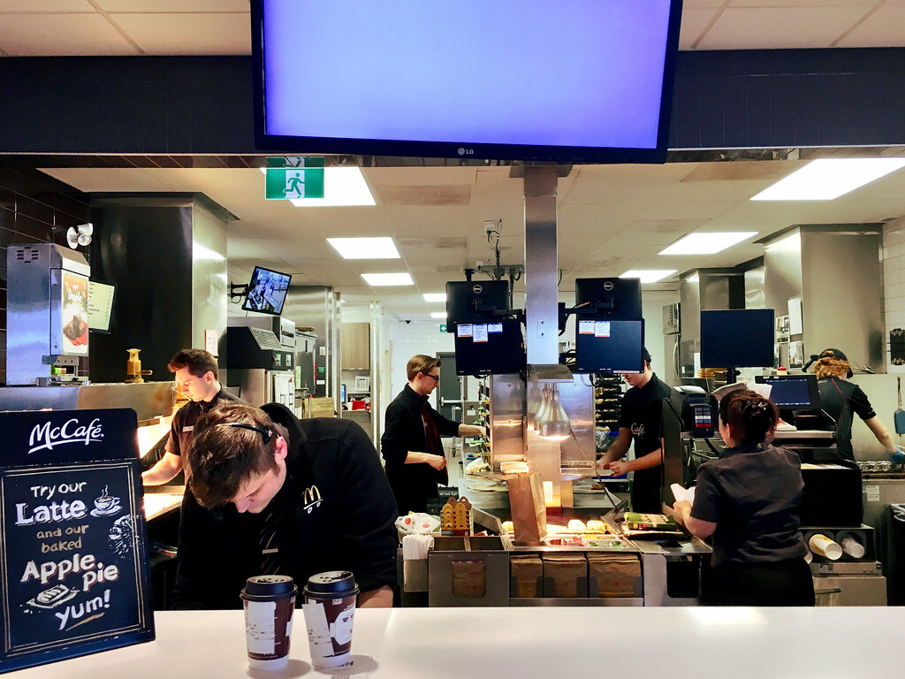
Machine Bureaucracy
Highly standardized, formalized processes ensuring efficiency and consistency.
Example: McDonald's, known for strict global operational procedures.

Slide 11
Mintzberg’s Configurations (1970s–1980s)
Headquarters
Regional & Country Managers
Technostructure
Support Staff
Restaurant Workers & Shift Managers
McDonald’s (standardized processes)
Machine Bureaucracy

Slide 12

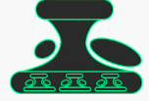
Professional organization
Characterised by many guidelines and procedures
But employees are independet
Focus on operational core
Diversified organization
Organisation according to product, various product groups under the guidance of one central heard office
Descentralised where each division has its own board
Notes:
Professional:
Free professions such as law firms, notaries, consultancy firms, universities…
High efficiency
Difficult to change
Diversified:
Focus middle management
Large organisations
Shell: oil, fuel, plastic, etc
Difference of opinion arise divisions

Slide 13

Professional Bureaucracy
Decentralized expertise-driven work, empowering skilled professionals.

Slide 14
Strategic Apex
Hospital director, executive board
Support Staff
Middle Line
Clinical directors,
Emergency Department (ED)
Pediatrics & Neonatology
Radiology & Imaging
Technostructure
Surgery & Operating Theatres
Operating Core

Slide 15
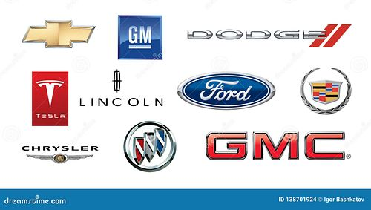
Divisionalized Form
Semi-autonomous divisions operating under a corporate headquarters.
Example: General Motors, with distinct brands like Chevrolet and Cadillac.

Slide 16
PepsiCo (as a multi-business corporation)
Strategic Apex
Executive Committee
Support and control
Communication
Finance
Leadership
Management
Beverages segment
Sales
Marketing
Operation
Food Products segment
Sales
Marketing
Operation
Food Service segment
Sales
Marketing
Operation

Slide 17

Adhocracy or innovative organization
Innovative organisation characterized by little fixed structure
Work on projects with multidisciplinary professionals
Adaptable but strict measures
Pharmaceutical / Consultancy firms

Slide 18
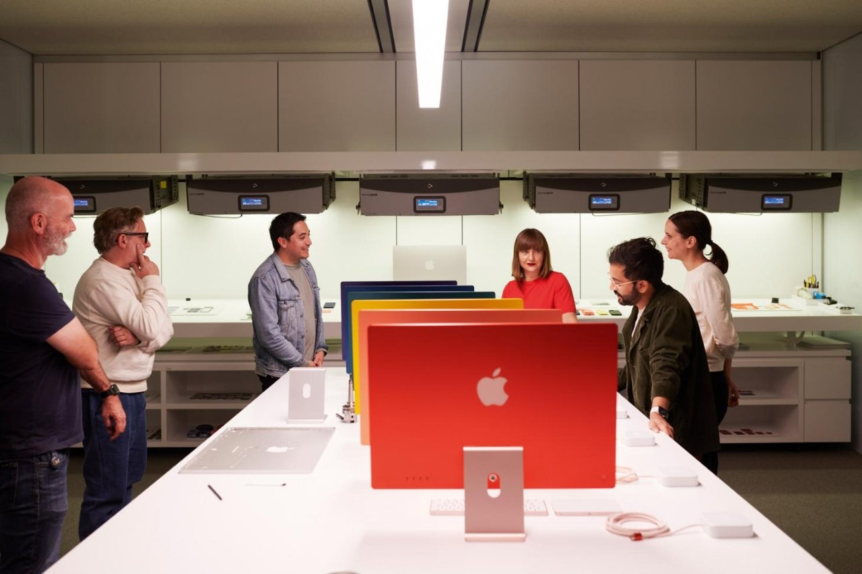
Adhocracy
Adhocracy
Flexible, project-based, innovative structure fostering rapid change and creativity.
Example: Apple's product development teams, driving continuous innovation.

Slide 19

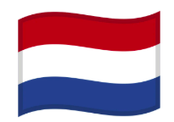
Mission organization
All target groups convey in this mission
Based on ideology
In– House production
Unified by shared ideology or mission rather than profit motives. High commitment to a collective cause.
Political organization
Power oriented
Doesn’t use a organisational structure
No other coordinating system
Notes:
Mission:
Hierarchy with top management (board), middle management and operational work floor, all managed by technological support and staff departments.
Apple
Diversified:
Not always clear and organisations float on whats important at the time in the political lobby and debates
The ones with more power, are in charge and control
Netherlands: leadership of various political parties

Slide 20
Core Idea
Organizations succeed when their structure matches their environment:
Stable environment → bureaucracy works
Fast-changing environment → adhocracy works
Small business → simple structure works
There is no perfect structure, only the right structure for the situation.

Slide 21
Thank You For Your Attention . . . !

Slide 22
References
Grant, R. M. (2007). Organization Structure and Management Systems (chapter PDF). Wiley-Blackwell
Chandler, A. D., Jr. (1962/1969). Strategy and Structure: Chapters in the History of the American Industrial Enterprise. MIT Press. Google Books+2Internet Archive+2
Hagley Museum and Library. E.I. du Pont de Nemours & Company Executive Committee records (finding aid). findingaids.hagley.org
Hagley Museum and Library. (2015). The DuPont Company’s Chart Room. hagley.org
Delaware Online. (2015). DuPont timeline (includes “line and staff” reference). delawareonline.com
Hendry, J. (n.d.). Mintzberg’s theory of organization structure (review paper PDF). johnhendry.co.uk
Galbraith, J. R. (1971). Matrix Organization Designs (classic article PDF). jaygalbraith.com+1
Galbraith, J. R. (1974). Organization Design: An Information Processing View (paper PDF; matrix referenced). sietmanagement.fr
Davis, S. M., & Lawrence, P. R. (1977). Matrix. Addison-Wesley. Google Books+1
University of Göttingen (source PDF). Case 13: Philips (matrix, “tilting” the matrix, NOs vs PDs). University of Göttingen
van der Eng, P. (2017). The Case of Philips in Australia, 1945–1980 (ANU working paper). rse.anu.edu.au
Chen, Y. (2020). Philips versus Matsushita: A Critical Review and Comparison (PDF; describes Philips NO/PD matrix). ResearchGate
Powell, W. W. (1990). Neither Market Nor Hierarchy: Network Forms of Organization (PDF). Stanford University
McKinsey & Company. (2014). The past and future of global organizations (PDF; evolution toward matrix and beyond). McKinsey & Company+1
McKinsey & Company. (1979/2014 PDF repost). Beyond the matrix organization (PDF). McKinsey & Company+1
GitLab. All-Remote | The GitLab Handbook. The GitLab Handbook+1
Automattic. (2025). Celebrating 20 Years of Automattic (fully distributed). Automattic
TechCrunch. (2021). The future of remote work is text (Automattic structure/async). TechCrunch
Kniberg, H. (2012). Scaling Agile @ Spotify (PDF). Crisp's Blog+1
Frynas, J. G., Mol, M. J., & Mellahi, K. (2018). Management innovation made in China: Haier’s Rendanheyi (accepted-version PDF). oro.open.ac.uk
Harvard Business School. Haier: Incubating Entrepreneurs in a Chinese Giant (case page). Harvard Business School
HolacracyOne. Holacracy Constitution v4.1 (official). Holacracy
Time. (2016). Zappos’ Weird Management Style Is Costing It More Employees (holacracy attrition context). TIME
PubMed / Monsen, K. A., et al. (2013). Buurtzorg: nurse-led community care (self-managed teams). PubMed
Martela, F. (2025). Buurtzorg: scaling up an organization with hundreds of self-managing teams… (Springer). SpringerLink
Commonwealth Fund. (2015). Home Care by Self-Governing Nursing Teams… (Buurtzorg model). commonwealthfund.org
Uber Technologies, Inc. (2021). Form 10-K (FY ended 2021-12-31) (describes platform connecting riders/drivers, etc.). SEC
Airbnb, Inc. (2024). Form 10-K (FY ended 2024-12-31) (marketplace model connecting hosts/guests). SEC
Parker, G. G., Van Alstyne, M. W., & Choudary, S. P. Platform Revolution (MIT IDE publication page). MIT Initiative on the Digital Economy
Gawer, A., & Cusumano, M. A. (2001). Driving High-Tech Innovation: The Four Levers of Platform Leadership (paper). ResearchGate
Benkler, Y. (2002). Coase’s Penguin, or, Linux and the Nature of the Firm (PDF / publication page). Benkler+2Yale Law Journal+2
Raymond, E. S. (2002 version online). The Cathedral and the Bazaar (author’s canonical page).

